Slide 1
AbilityOne Program
U.S. AbilityOne Commission
National Industries for the Blind (NIB)
SourceAmerica
Nonprofit Agency Contractor
Federal AbilityOne Champion

Slide 2
U.S. AbilityOne Commission
Nancy Myrick

Slide 3
AbilityOne Program Overview
The AbilityOne® Program is a government purchasing program that provides employment opportunities for people who are blind or have significant disabilities
Jobs are created/maintained through the sale of products and services to the federal government
The AbilityOne workforce of more than 45,000 individuals works in a variety of manufacturing and service industries
The AbilityOne Program strives to reduce the unacceptably high percentage (70%) of Americans with disabilities who do not have jobs
The program has more than $2.8 billion in annual revenue
The Department of Defense (DoD) and General Services Administration (GSA) are the largest federal customers

Slide 4
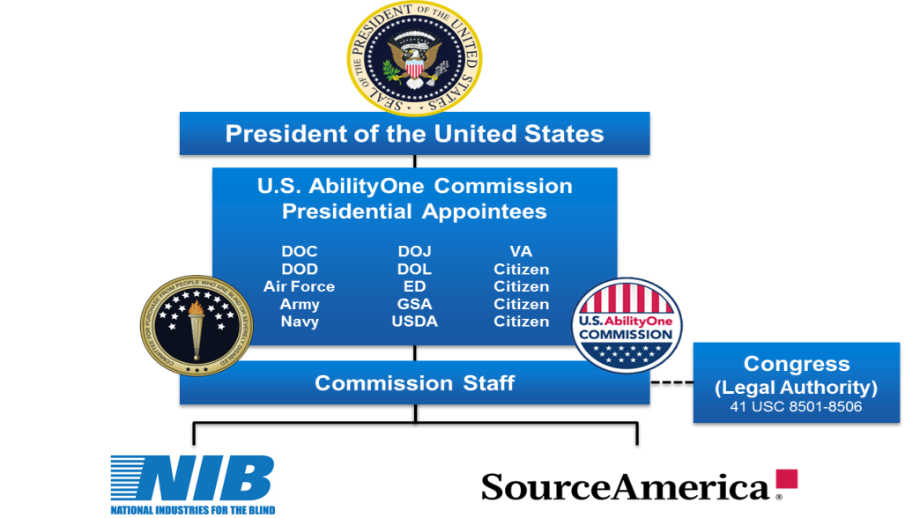
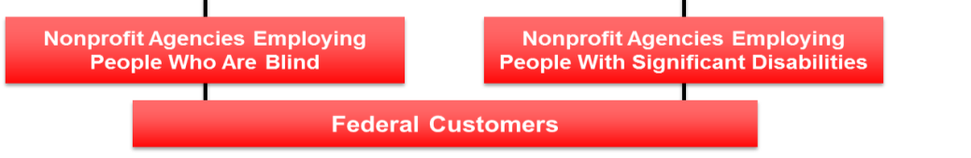
AbilityOne Structure
An AbilityOne® Authorized Enterprise
An AbilityOne® Authorized Enterprise

Slide 5


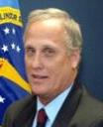







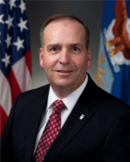
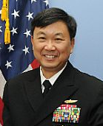
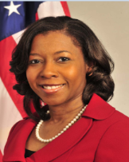


U.S. AbilityOne Commission Members
J. Anthony Poleo
Chairperson
Dept of Defense
James Kestleloot
Vice Chairperson
Private Citizen
Robert Kelly, Jr.
Private Citizen
Karen McCulloh
Private Citizen
Anil Lewis
Private Citizen
P. Edward Anthony
Dept of Education
William Sisk
General Services Admin
Jan Frye
Dept of Veterans Affairs
Lisa Wilusz
Dept of Agriculture
Harry Hallock
Dept of Army
Thomas Robinson
Dept of Air Force
RADM Jonathan A. Yuen
Dept of Navy
Virna Winters
Dept of Commerce
Vacant
Vacant

Slide 6
Statutory/Regulatory Framework
Statutes/Regulations
agency Guidance
Commission
Purchase Memoranda*
Javits-Wagner-O’Day Act, 41 U.S.C. 8501 - 8506
Establishes Committee as an independent Federal agency; specifies composition, duties and staff
Committee Regulations - 41 CFR 51
FAR 8.002, Priorities for use of mandatory Government sources
FAR Subpart 8.7 – Acquisition from Nonprofit Agencies Employing People Who Are Blind or Severely Disabled
DFARS Procedures, Guidance, and Instructions (PGI) 207.105, Contents of written acquisition plans
Office of the Under Secretary of Defense,
Increasing Contracting Opportunities with the AbilityOne Program, July 12, 2012
Department of Health & Human Services,
Increasing Contracting Opportunities with the AbilityOne Program, July 18, 2010
Department of Homeland Security,
Increasing AbilityOne Program Contracting Opportunities, May 13, 2010
Department of Agriculture, USDA Departmental Regulation 5080-001 May 23, 2007
Pricing (PR) Memorandum No 1, Fair Market Pricing Policy, April 1, 2007
PR No 2, Fair Market Price Determination for AbilityOne Product Contracts, January 26, 2007
PR No 3, Fair Market Price Determination for AbilityOne Service Contracts, January 26, 2007
PR No 19, AbilityOne Price and Price-Related Impasse and Dispute Resolution Procedures, March 16, 2007
Operations (OPS) 21, Guidance on Nonprofit Agency Establishment of Subcontract Relationships for Current or Potential Procurement List Projects, May 1, 2008
*Commission pricing policy currently being updated.
Notes:
[Many agencies have specific guidance.]

Slide 7
AbilityOne Definition of Blind or Significantly Disabled
Blind means an individual or class of individuals whose central visual acuity does not exceed 20/200 in the better eye with correcting lenses or whose visual acuity, if better than 20/200, is accompanied by a limit to the field of vision in the better eye to such a degree that its widest diameter subtends an angle no greater than 20 degrees
Severely Disabled means a person other than a blind person who has a severe physical or mental impairment (residual limiting condition resulting from an injury, disease, or congenital defect) which so limits the person’s functional capabilities (mobility, communication, self-care, self-direction, work tolerance, or work skills) that the individual is unable to engage in normal competitive employment over an extended period of time
41 C.F.R. 51-1.3

Slide 8

Procurement List Addition Process
Identification of Requirement
Consider AbilityOne Solution
Contact AbilityOne at 1-800-999-5963
Review a “No obligation” price proposal
Negotiate price, & other terms & conditions with CNA
CNA sends addition request to Commission
U.S. AbilityOne Commission analysis
Rulemaking
Suitability (includes Impact Analysis)
Determines Fair Market Price
PL Addition decision by U.S. AbilityOne Commission
Notice to Contracting Officer
Contract award authorized
6
7

Slide 9
Suitability Criteria
The Commission staff reviews the suitability of the product or service project in terms of NPA qualifications, employment potential, and NPA capability. Additionally they analyze the impact on the current contractor and evaluates the recommended price
Upon completion, and in accordance with the Administrative Procedures Act, the proposed requirement will be posted to the Federal Register for an initial 30-day notice and comment, the rulemaking period begins

Slide 10
Fair Market Price Determination
Fair Market Price recommendations submitted in the AbilityOne Program must:
Be negotiated and agreed to by the Contracting Activity(s) and the Nonprofit Agency before submission
Be analyzed in accordance with FAR 15.404 by the Contracting Officer

Slide 11
Benefits to the Customer
Strategic Partner – National Network
Customized Solutions
Long-term Partnerships
Reduced procurement cycles
Fair Market Price/Best Value
Surge capability and responsiveness
Leverage current procurement list addition

Slide 12
Contact Us
www.abilityone.gov
Email: info@abilityone.gov

Slide 13
National Industries for the Blind
Scottie Knott

Slide 14

Meet NIB
NIB is a 501(c) 3 nonprofit organization established in 1938 to create, sustain and improve employment opportunities for people who are blind or visually impaired
Working with a nationwide network of associated agencies across the country, NIB develops business opportunities in federal, state and commercial marketplaces
NIB and its associated agencies are the largest employment resource for people who are blind in the United States
5,600+ employees who are blind
$600M+ in annual sales
7,000+ products/services
94 associated agencies
250 locations nationwide
152 Base Supply Centers
77+ years of experience

Slide 15
NIB Associated Agencies and BSCs
94 Associated Nonprofit Agencies
152 Base Supply Centers (BSCs)
Associated Agencies
BSCs
As of 2-10-2015
Notes:
19 Locations:
Orlando, FL – Lighthouse Central Florida
Atlanta, GA - Center For The Visually Impaired
Chicago, IL - The Chicago Lighthouse for People Who Are Blind or Visually Impaired
Buffalo, NY - Elizabeth Pierce Olmsted, M.D. Center for the Visually Impaired
Baltimore, MD - Blind Industries and Services of Maryland
Indianapolis, IN - Bosma Enterprises
Utica, NY - Central Association for the Blind and Visually Impaired
Raleigh, NC - RLCB, Inc.
Rochester, NY - Association for the Blind and Visually Impaired - Goodwill
Milwaukee, WI - Associated Industries for the Blind, Inc.
Jackson, MS - Mississippi Industries for the Blind
Little Rock, AR - Arkansas Lighthouse for the Blind
Morristown, TN - Lions Volunteer Blind Industries, Inc.
Cleveland, OH - Cleveland Sight Center
Seattle, WA - The Lighthouse for the Blind, Inc.
Dallas, TX - Dallas Lighthouse for the Blind, Inc.
San Antonio, TX - San Antonio Lighthouse for the Blind
Winston-Salem, NC - Winston-Salem Industries for the Blind, Inc.
Kansas, MO - Alphapointe Association for the Blind

Slide 16


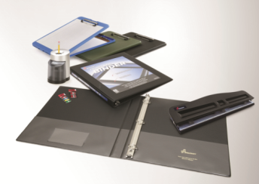

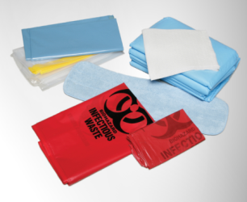
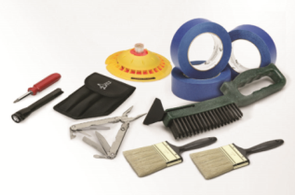
NIB Products – Primary Lines of Business
OFFICE SUPPLIES
JANITORIAL/ SANITATION (JAN/SAN)
MAINTENANCE, REPAIR,
AND OPERATIONS (MRO)
MEDICAL
AND
SAFETY
“Environmentally Sustainable”
“Environmentally Sustainable”
Pens, pencils, markers
Tapes & adhesives
Computer accessories
Paper – copier, pads, etc.
Binders & portfolios
White boards, cork boards
Mops, brooms, brushes
Cleaning chemicals
Sanitary papers
Hand sanitizers
Lunch room supplies
Trash bags
Paints and supplies
Tools, tool bags & kits
Floor mats
Cords and ropes
Hoses
Solvents
First aid kits
Safety vests
Personal grooming
Hospital bedding & PJs
Ambulance litters
Medical gloves

Slide 17



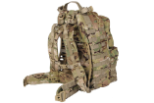

NIB Niche and Textiles
OTHER MILITARY CLOTHING
PHYSICAL FITNESS
ORGANIZATIONAL CLOTHING
ORGANIZATIONAL EQUIPMENT
Moisture Wicking T-shirt
Air Force Battle Dress Uniform
Navy Work Uniform – Types II & III
Army Combat Shirt
Fleece Liner
Improved Phy Fit Uniform (IPFU)
USAF PTU
USCG Running Suit/Trunks-T-Shirt
Extreme Cold Weather Clothing System (ECWCS) Items - Layer 2 and 4
Flight Deck Jersey
Modular Light-weight Load Carrying Equipment (MOLLE)
Advanced Combat Helmet (ACH) Covers, Pads, Retention System
Ballistic Nape Pad
E-Tool Cover
Hydration system
Gloves
Aerial Delivery Systems

Slide 18

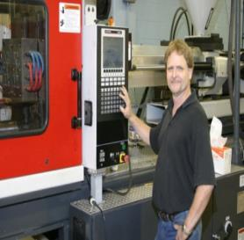


NIB Services
CONTACT CENTER SERVICES
SUPPLY CHAIN SERVICES
ADMINISTRATIVE/ TECHNOLOGY SERVICES
CONTRACT MANAGEMENT SUPPORT
Switchboard
Order Processing
Call Centers
Help Desk Support
Warehousing and Distribution
Kitting and Assembly
Package Reclamation
Parts Machining
General Clerical Services
Mail Management Support Services
Transcription Services
Document Conversion/Digital Imaging
Document Destruction
Data Entry
Copy Center Operations
Section 508 Assurance Service
Prepare “ready to close” contract file
Administrative services in support of contract closeout
Prepare de-obligation modifications
Non-inherently governmental function
Utilizes Strategic Sourcing Solution

Slide 19
How we do it . . . or getting rid of the myths about blindness
“No Fear” technology levels the playing field
NIB provides necessary expertise to remediate customer technology
Screen/text readers
PC or server based
Dual use Headphones
Mobility Skills
Job Ready Testing
Workplace blindness awareness training

Slide 20
Past Performance Examples
Supply Chain Services
Contact Centers
Contract Close Out
Products

Slide 21
How to Engage with NIB
Products on the PL have multiple channels:
E-commerce: AbilityOne.com; utilize Government Purchase Card
Base Supply Centers: Visit NIB.org for locations
General Services Administration – Requisition ordering
Defense Logistics Agency – Requisition Ordering
AbilityOne Authorized Distributors: Visit AbilityOne.gov for a list
Online AbilityOne catalog: AbilityOneCatalog.com
All Services: VP, Services 703-310-0371 or services@nib.org
GSA Schedules and other IDIQs are available for your use
New Products: VP, Business Development 703-310-0375

Slide 22
SourceAmerica
Paul Koepfinger

Slide 23

SourceAmerica – Who are we?
SourceAmerica® is a central nonprofit agency (CNA)
Responsible for evaluating and recommending NPAs for AbilityOne opportunities to the U.S. AbilityOne Commission
Provides acquisition strategy planning with each Federal agency for future opportunities
Provides quality control and subject matter expert support
Facilitates contract negotiation and startup assistance
40,000+ people with disabilities employed
$2.2B+ in annual sales
500+ associated nonprofit agencies
40+ years experience

Slide 24


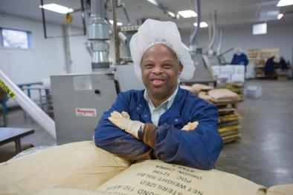

SourceAmerica Products
Clothing and textiles
Food processing and packaging
Supplies and equipment
Hardware, office, medical
Manufacturing and Development (M&D)

Slide 25

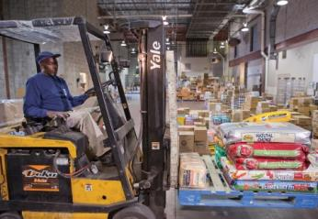
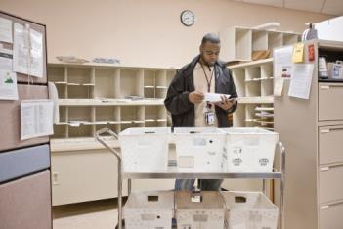


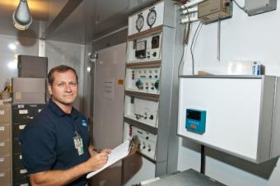
SourceAmerica Services
Administrative
Commissary shelf stocking
Contact Center/IT Support
Custodial
Document and records management
Electronics recycling
Fleet management
Food services
Grounds maintenance
Healthcare environmental
Kitting
Laundry
Secure document destruction
Secure mail
Supply chain management
Total facility management

Slide 26
SourceAmerica Services – FY14
Line Of Business | Number of Contracts | FY14 Annual Value
Custodial Services | 942 | $666,834,547
Total Facility Mgmt | 61 | $316,375,141
Food Service | 98 | $251,985,374
Contact Center | 37 | $153,114,479
Commissary | 99 | $91,749,913
Grounds | 156 | $70,316,561
Supply Chain | 35 | $64,988,044
Mail Services | 143 | $57,115,877
Healthcare Environmental | 26 | $56,415,685
Administrative Services | 94 | $54,468,937
Laundry | 75 | $27,154,161
Fleet Management | 13 | $18,624,560
All Other Services | 26 | $13,654,649
Hospitality | 6 | $7,136,978
Recycling | 13 | $4,476,392
Document Management | 11 | $3,916,175
Document Destruction | 73 | $2,249,712
Retail Services | 1 | $460,972
M&D | 26 | $31,236
Total Annual Sales | 1935 | $1,861,069,393

Slide 27
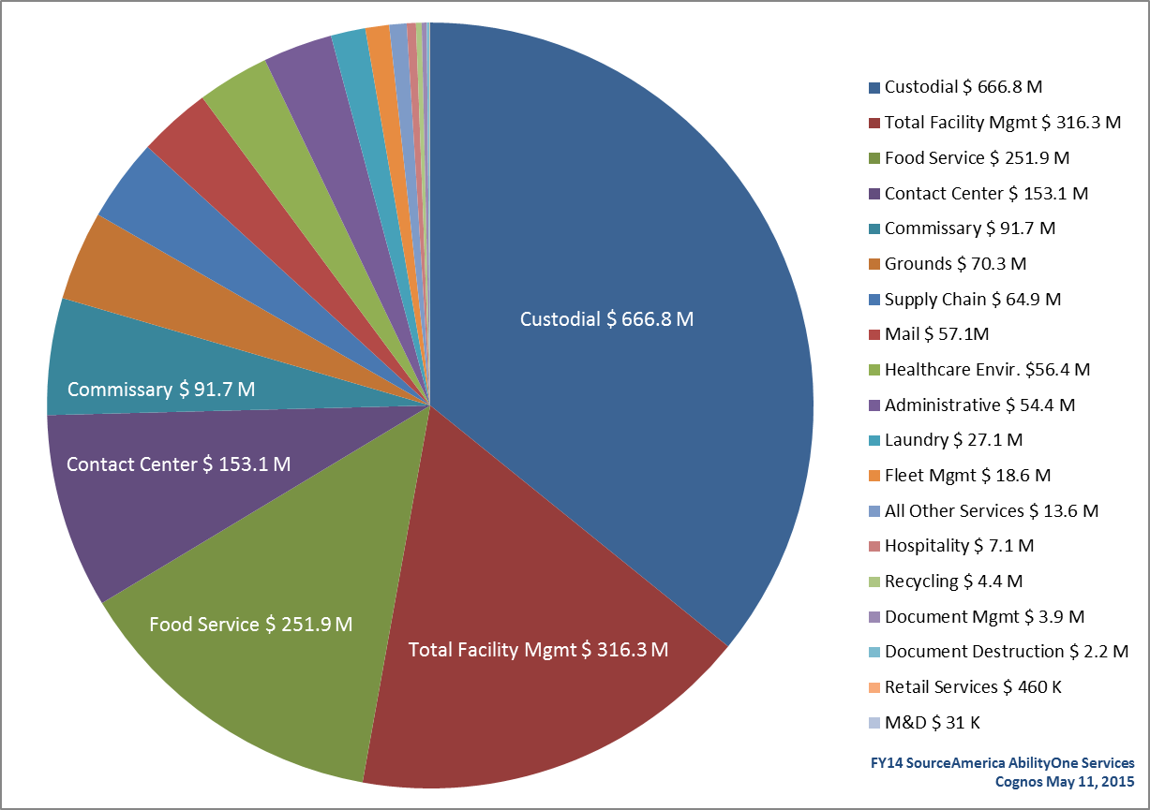
SourceAmerica Services – FY14

Slide 28
The AbilityOne Procurement List
The Commission maintains a Procurement List of products and services that have been placed in the AbilityOne Program, as referenced in FAR Subparts 8.0 and 8.7
Once a product or service is on the Procurement List, the government must buy it from the organization designated by the Commission until the government no longer has requirements for that item, or until a nonprofit agency employing people who are blind or have significant disabilities can no longer furnish that item
Procurement List can be found at:
http://abilityone.gov/procurement_list/index.html

Slide 29
Federal Acquisition/AbilityOne Process
Identification of Requirement
or Need
Market Research
(FAR Part 10)
Acquisition Planning
(FAR Part 7)
Solicitation and
Proposal Phase
(FAR Part 15)
Evaluation and Negotiation
(FAR Part 15)
Source Selection and Contract Award
(FAR Part 15)
90-120 day process for Commission Procurement List Addition
Functions within legal/regulatory framework implemented by the FAR
Involves entire acquisition team
Balances goals of obtaining best value for the government and promoting competition

Slide 30
Contact Us
To schedule a briefing about SourceAmerica’s products or services, call (888) 411-8424
http://www.sourceamerica.org/about-us/contact-us-form

Slide 31
Videos to learn more
AbilityOne Program Overview
SourceAmerica: 2013 – AbilityOne Honor Roll for Veterans with Disabilities Award Winner
NOTE: Right click on hyperlink to open

Slide 32
Nonprofit Agency Contractor
Rick Sebastian, Didlake

Slide 33
Capable Workforce
Untapped labor market of high achieving and performing individuals who increase sustainable returns on investments for customers and communities
More than 45,000 people who are blind or have significant disabilities show up for work each day and deliver high quality products and services to end customers
Multiple public and private partnerships exist to support workforce development
ADA
Vocational Rehabilitation via the Rehabilitation Services Administration
Office of Disability and Employment Policy
Workforce Innovation and Opportunity Act (WIOA)

Slide 34
Strategic Sourcing
Leveraging the National network providing single point of contact for One Stop activity for all sourcing and procurement/acquisition needs
NPAs actively partner with Disadvantaged, Small and Big Business creating opportunity for multiple contracting goals to be met via one contracting vehicle
Total Supply Chain and Vendor Management
Competitive Bid Process for all required subcontracted products and services
Active Management of Berry & Kissel Amendment, Buy American, Trade and other identified Agreements
GSA, DLA, USDA, US Air Force, Department of State, Product Manager Force Sustainment Systems (PM-FSS)

Slide 35
Technical/Quality/Past Performance Qualifications
Decades of delivering excellence
Scope of Work, Performance Work Statements and Statements of Need
ISO, CIMS, JCOH certifications, registrations and standards
Prime Vendor Mentor Protégé opportunities and technical performance enhancement

Slide 36
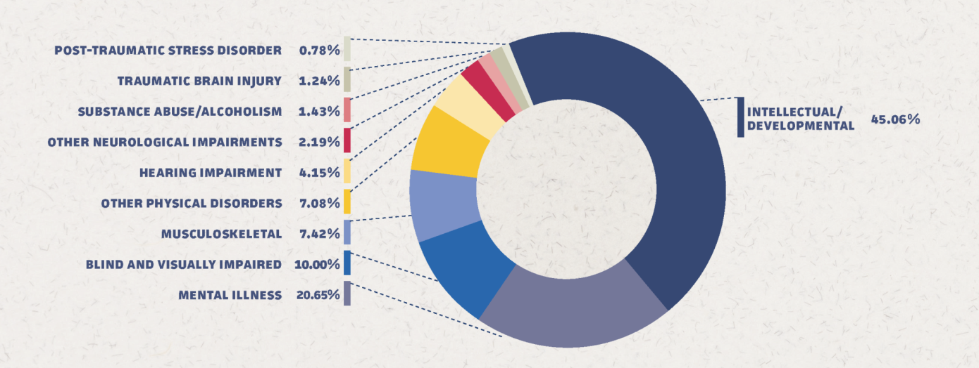
Primary Disability Type
*Source: NIB and SourceAmerica. FY2014.

Slide 37
Race and Ethnicity
*Dataset represents 28,800 eligible AbilityOne Employees.
Source: ERS, AbilityOne Workforce from SourceAmerica Producing NPAs. FY 2015, Q1.

Slide 38
Veterans Status
*Dataset represents 28,800 eligible AbilityOne Employees.
Source: ERS, AbilityOne Workforce from SourceAmerica Producing NPAs. FY 2015, Q1.

Slide 39
Work Location Type
*Dataset represents 28,800 eligible AbilityOne Employees.
Source: ERS, AbilityOne Workforce from SourceAmerica Producing NPAs. FY 2015, Q1.

Slide 40
Average Hourly Wage (excluding H&W)
*Dataset represents 28,800 eligible AbilityOne Employees.
Source: ERS, AbilityOne Workforce from SourceAmerica Producing NPAs. FY 2015, Q1.

Slide 41
U.S. Department of Agriculture
Al Muñoz

Slide 42
What to expect when you contract with AbilityOne
Fewer steps, but can be a longer process
Involves procedures with which you may be unfamiliar – but help is available
Resistance from Stakeholders
Lack of familiarity
Need to get things done
Questions about suitability

Slide 43
Why should you contract with AbilityOne?
Quality products at reasonable prices
Stable workforce
Eliminates the need to re-compete the contract, forever
Allows people who are blind or have other significant disabilities an opportunity to gain meaningful employment, lead more independent lives, reduce dependence on government social programs and become taxpayers

Slide 44
Why should you contract with AbilityOne?
AbilityOne depends on Government contracts to create training and employment opportunities
Only through our efforts can AbilityOne accomplish its mission
Because it’s a worthwhile endeavor – providing jobs for people who otherwise may never find one
Contracting with AbilityOne results in more meaningful and more purposeful business solutions

Slide 45
For more information
AbilityOne.gov
SourceAmerica.org
NIB.org
CouncilofChampions@abilityone.gov

